Slide 1
Generative Model for
Recommendation Improvements:
A Mixed Bayesian Approach
The Bayesian Explorers
7/26/21
Notes:
Better name for presentation?
Still need group name

Slide 2
Outline
Introduce team members/mentors (need to come up with team name)
Background:
Mention problem, goal, and benefit to company
Zipzones (map??)
Current models (all Z3->Z3):
Diagram (overall process of generating data - 2 parts)
Best fit distributions for independent columns:
Show some examples (superimpose original and generated)
Hierarchical model:
Describe math behind model
Show either rate or cost generated data and original data
BBN:
Describe math behind model
Show some statistics on how it’s performing
Pictures?
Route ahead:
Expanding to other zipzones
Play with structure of graph (other dependencies?)
Testing our model

Slide 3
Project Collaborators
Team Members:
Muharrem Baris Otus
Samanwita Samal
Lauren Snider
Sijie Tang
Miao Zhang
Ahmed Zytoon
Mentors from C.H. Robinson:
Natalie Heer, Senior Data Scientist
Michael Chmutov, Data Scientist
Bethany Stai, Data Scientist
Mentors from IMA:
Daniel Spirn
Thomas Höft

Slide 4
Content
Problem and goal
Modeling and results
Bayesian Hierarchical Model
Bayesian Belief Network
Future plan

Slide 5
C.H. Robinson’s Order Decision Process
Recommender
System
Yellow or Red
Account Team
Customer
(Shipper)
Places Order
Green
Acceptance
Rejection
CustomerWithdraws
Notes:
Some greens get rejected too right?

Slide 6
Problem
C.H. Robinson needs a platform on which to test improvements to their recommender system.
Proposed solution
Use of Bayesian methods to produce a parametric model of the order decision process which generates synthetic data.
Business Impact
De-risk improvements to the recommender system and make order processing more efficient.
Notes:
Mention model needs to be explainable, that is why we choose Bayesian approach

Slide 7
A Three Layer Generative Model
Independent columns are generated by fitting the best distribution to that column
Order Information
(order_origin_weight, order_distance, order_num_stops, order_equipment_type)
Time
(lead_days,
weekday, week_id)
Rate
(rate_norm)
Estimated Cost
(est_cost_norm)
Recommender Outcome
(color)
Final Decision
(CurrentCondition)
Notes:
Need to add slide title
Generative models for each layer? Ways to generate different columns?
Other Idea: A Three Step (or Layer?) Generative Model

Slide 8
A Three Layer Generative Model
Order Information
(order_origin_weight, order_distance, order_num_stops, order_equipment_type)
Time
(lead_days,
weekday, week_id)
Rate and estimated cost are generated by Bayesian Hierarchical Modeling
Rate
(rate_norm)
Estimated Cost
(est_cost_norm)
Recommender Outcome
(color)
Final Decision
(CurrentCondition)
Notes:
Slide needs title

Slide 9
A Three Layer Generative Model
Order Information
(order_origin_weight, order_distance, order_num_stops, order_equipment_type)
Time
(lead_days,
weekday,
week_id)
Rate
(rate_norm)
Estimated Cost
(est_cost_norm)
Recommender Outcome and Final Decision are generated by Bayesian Belief Network
Recommender Outcome
(color)
Final Decision
(CurrentCondition)
Notes:
Slide needs title

Slide 10
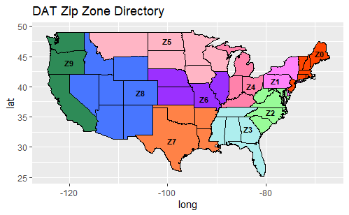
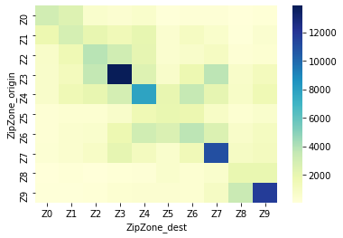
Order Volume by Zip Zone Pair
Notes:
Restriction of data right? Since model will be different when we include all data

Slide 11
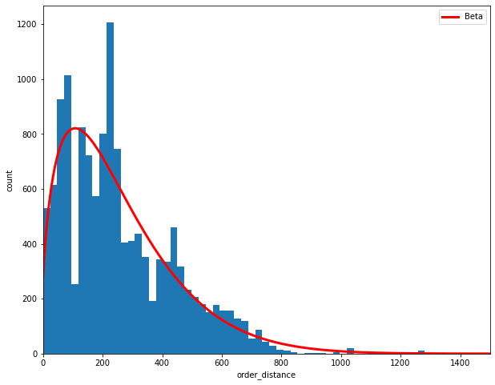
Fitting Distributions to Continuous Independent Columns
Order_distance ~ Beta(α=1.617, β=14.258)
Notes:
We can also add the formula for beta distribution?

Slide 12
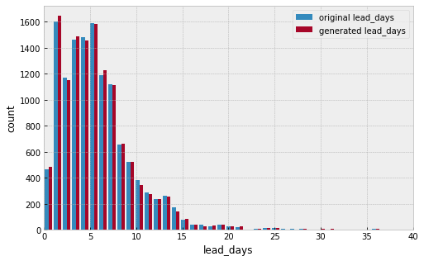
Multinomial Distribution to Discrete Independent Columns
Notes:
Another title to be consistent to the previous title? Like multinomial distribution for discrete variables

Slide 13
Bayesian Hierarchical Model
Bayes’ Theorem:
P(B|A)P(A)
P(A|B) =
P(B)
Statistical model which estimates a posterior distribution via a “hierarchy” of priors
Posterior computed through Markov chain Monte Carlo methods
Allows for partial pooling of parameters (e.g. by Zip Zone)
Notes:
Parameters = priors and hyperpriors
P(A|B) = posterior, P(A) = prior, P(B|A) = likelihood, P(B) = marginal

Slide 14
Bayesian Hierarchical Model
Bayes’ Theorem:
P(B|A)P(A)
P(A|B) =
P(B)
Statistical model which estimates a posterior distribution via a “hierarchy” of priors
Posterior computed through Markov chain Monte Carlo methods
Allows for partial pooling of parameters (e.g. by Zip Zone)
Notes:
Parameters = priors and hyperpriors
P(A|B) = posterior, P(A) = prior, P(B|A) = likelihood, P(B) = marginal
I thought it would be nice if we could use theme color for these slides. Feel free to delete it if you prefer otherwise

Slide 15
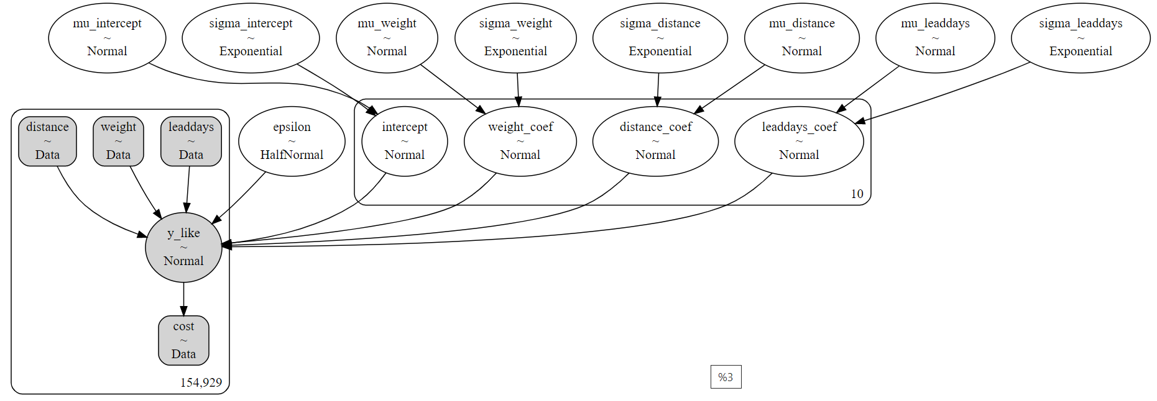
A Partially Pooled Model of Cost
Notes:
Mention how mu of y_like is linear regression that’s indexed by ZipZone_origin

Slide 16
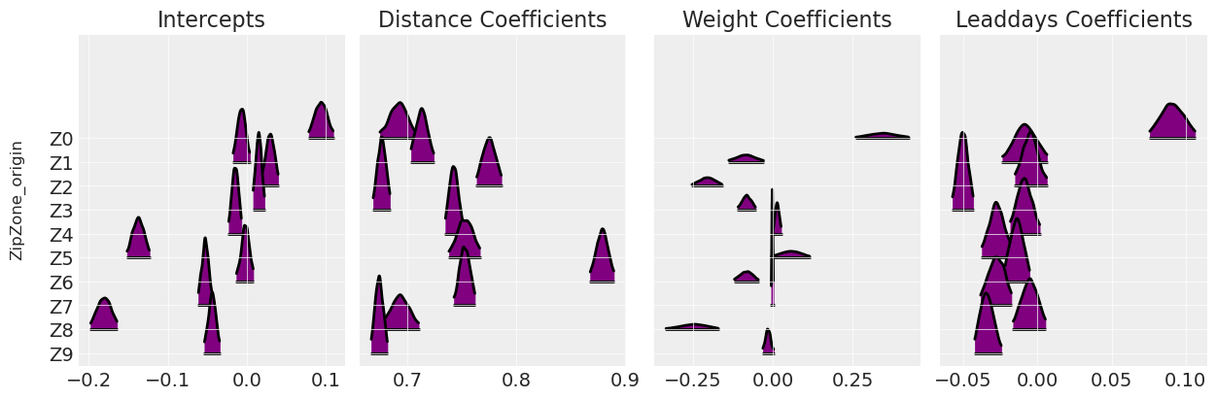
Traces of the Coefficients in Our Model
?
Notes:
Add the regression equation too? (Strongly agree to this since it’s a technical presentation)

Slide 17
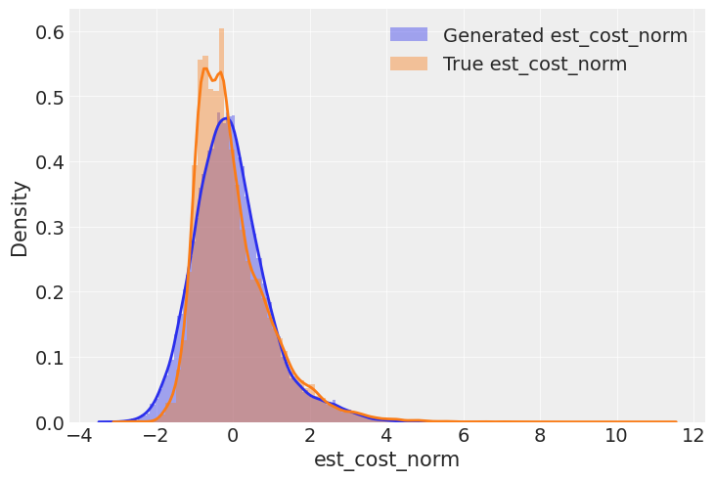
Is Our Model Generating Realistic Cost Data?
Notes:
Kernel Density Estimation plot
Future: Need some non visual measure of accuracy of predicted est_cost_norm

Slide 18
Bayesian Belief Network (BBN)
Probabilistic graphical model
Specifies which variables are dependent, independent, or conditionally independent
Tracks in real-time how each event's probabilities change as new evidence is introduced to the model

Slide 19
Bayesian Belief Network (BBN)
Probabilistic graphical model
Specifies which variables are dependent, independent, or conditionally independent
Tracks in real-time how each event's probabilities change as new evidence is introduced to the model
Notes:
I thought it would be nice if we could use theme color for these slides. Feel free to delete it if you prefer otherwise

Slide 20
Simple BBN for Recommender and Final Outcomes
Rate
(rate_norm)
Estimated Cost
(est_cost_norm)
Recommender Outcome
(color)
Final Decision
(CurrentCondition)
Notes:
Parameters = priors and hyperpriors
P(A|B) = posterior, P(A) = prior, P(B|A) = likelihood, P(B) = marginal

Slide 21
Simple BBN for Generating Recommender Outcomes
Rate
(rate_norm)
Estimated Cost
(est_cost_norm)
cost | ≤ -2 | ≤ 0 | ≤ 2 | ≤ 4
P
rate | ≤ -2 | ≤ 0 | ≤ 2 | ≤ 4
P
Recommender Outcome
(color)
Categories color | GREEN | RED | YELLOW
rate ≤ -2 & cost ≤ -2
rate ≤ -2 & cost ≤ 0
…
rate ≤ 4 & cost ≤ 4

Slide 22
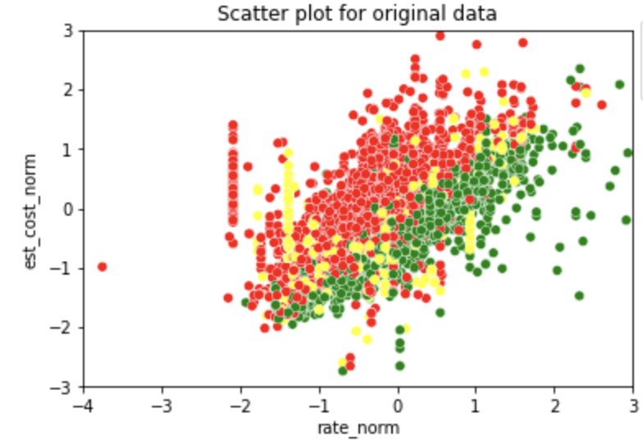
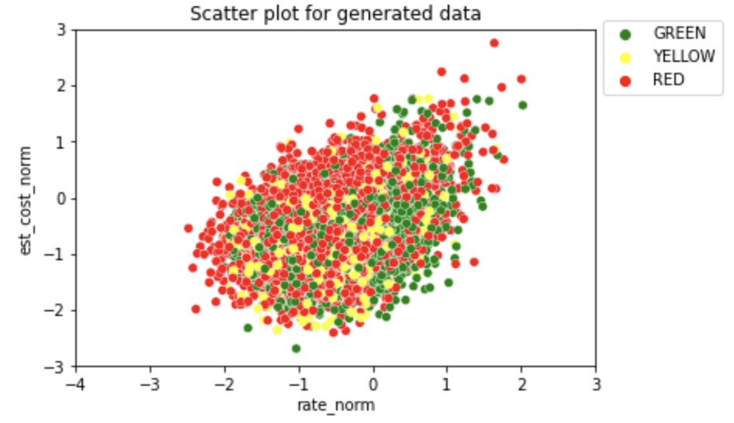
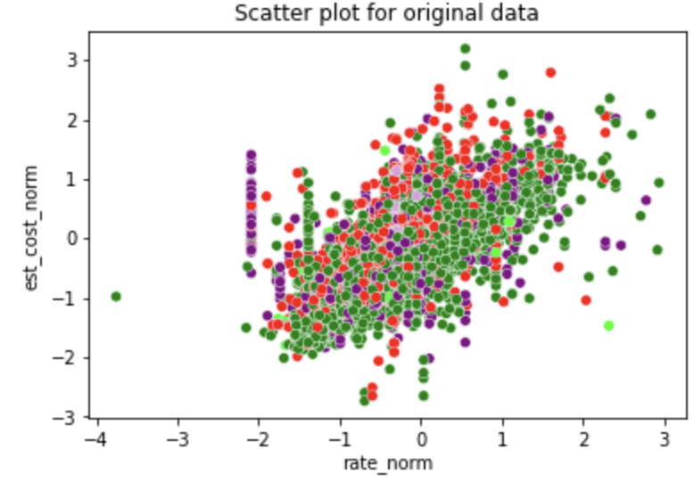
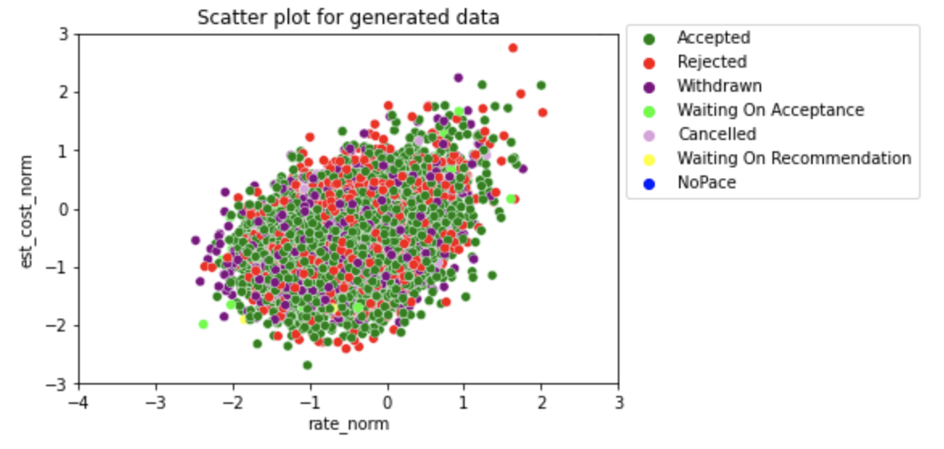
BBN results

Slide 23
Improvement and Evaluation of Model
Consider other zip zone pairs, like Z9 to Z9 and Z7 to Z7
Use more independent columns (week_id, weekdays, order_num_stops and order_equipment_type) and account for possible covariance
“Break apart” some multimodal distributions as a combination of several distributions
Make the hierarchical model and BBN iterative, taking posteriors as priors in next iteration
Use statistical tests like the Kolmogorov-Smirnov test (KS test) and Bayesian information criterion (BIC) to test the model
Notes:
“Break apart” some multimodal distributions as a combination of several distributions
Add other zipzones
Use more independent columns
Account for covariance in independent columns
Methods to test model (need to look at links that Natalie sent Friday) Kolmogorov–Smirnov test and Bayesian information criterion
For hierarchical and BBN, taking posteriors as priors in next iteration

Slide 24
Thank you.

